Slide 1
CHAPTER Asymmetric
18 Information

Slide 2
Asymmetric Information
Transactions can involve a considerable amount of uncertainty
  Can lead to inefficiency when one side has better information
Asymmetric information
  The side with better information
    Private information

Slide 3
The Value of Contracts
Contractual provisions
  Can be added in order to circumvent some of the inefficiencies associated with asymmetric information
  Rarely do they eliminate them

Slide 4
Principal-Agent Model
Principal
  The party who proposes the contract
Agent
  The party who decides whether or not to accept the contract
  And then performs under the terms of the contract
  Typically the party with asymmetric information

Slide 5
Two Leading Models
Moral hazard model
  The agent’s actions affect the principal, but the principal does not observe the actions directly
  Hidden-action model
Adverse selection model
  The agent has private information before signing the contract (his type)
  Hidden-type model

Slide 6
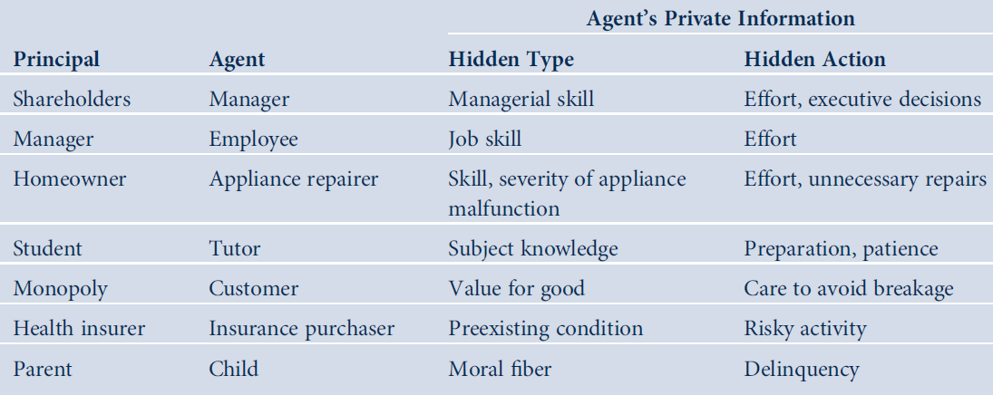
18.1 Applications of the Principal-Agent Model

Slide 7
First, Second, and Third Best
First-best contract
  Full-information environment
  The principal could propose a contract that maximizes joint surplus
    Could capture all of the surplus for himself
    Leaving the agent just enough to make him indifferent between agreeing to the contract or not

Slide 8
First, Second, and Third Best
Second-best contract
  The contract that maximizes the principal’s surplus
  Subject to the constraint that he is less well informed than the agent
Adding further constraints
  Leads to the third best, fourth best, etc.

Slide 9
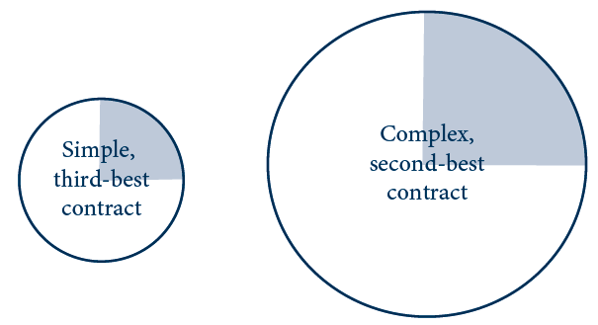
18.1 (a) The Contracting ‘‘Pie’’
(a) Complex contract increases parties’ joint surplus
The total welfare is the area of the circle (‘‘pie’’); the principal’s surplus is the area of the shaded region. In panel (a), the complex contract increases total welfare and the principal’s surplus along with it because she obtains a constant share.

Slide 10
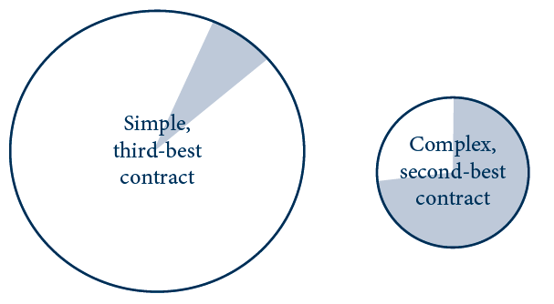
18.1 (b) The Contracting ‘‘Pie’’
(b) Complex contract increases principal’s share of surplus
The total welfare is the area of the circle (‘‘pie’’); the principal’s surplus is the area of the shaded region. In panel (b), the principal offers the complex contract—even though this reduces total welfare—because the complex contract allows her to appropriate a larger share.

Slide 11
Hidden Actions
The principal
  Would like the agent to take an action that maximizes their joint surplus
The agent’s actions
  May be unobservable to the principal
  The agent will prefer to shirk
Contracts
  Can mitigate shirking by tying compensation to observable outcomes

Slide 12
Hidden Actions
The principal
  More concerned with outcomes than actions
    May as well condition the contract on outcomes
The problem
  Outcome may depend on random factors
  Tying the agent’s compensation to outcomes exposes the agent to risk
  If the agent is risk averse: payment of a risk premium before he will accept the contract

Slide 13
Owner-Manager Relationship
A firm: one owner and one manager
  The owner (principal) offers a contract to the manager
  The manager (agent) decides whether to accept the contract and what action e ≥ 0 to take
    An increase in e increases the firm’s gross profit but is personally costly to the manager

Slide 14
Owner-Manager Relationship
The firm’s gross profit: π_{g} = e + ε
  Where ε represents demand, cost, and other economic factors outside of the agent’s control
    Assume ε ~ (0,σ²)
  c(e) is the manager’s personal disutility from effort; assume c’(e) > 0 and c’’(e) < 0
Firm’s net profit: π_{n} = π_{g} – s
    Where s is the manager’s salary

Slide 15
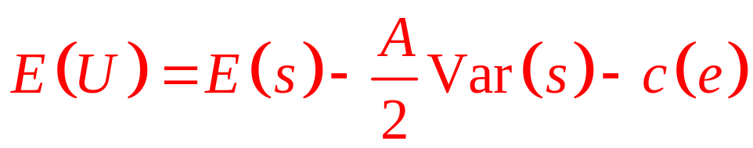
Owner-Manager Relationship
Risk-neutral owner
  Maximize the expected value of profit
  E(π_{n}) = E(e + ε – s) = e – E(s)
Risk adverse manager
  Constant risk aversion parameter, A > 0
  Manager’s expected utility:

Slide 16
First Best (Full-Information Case)
Optimal salary contract
  The owner can pay the manager
    A fixed salary s* if he exerts a first-best level of effort e*
    And nothing otherwise
  For the manager to accept the contract (participation constraint)
  E(U) = s* - c(e*) ≥ 0

Slide 17
First Best (Full-Information Case)
The owner
  Will pay the lowest salary possible [s* = c(e*)]
  Net profit: E(π_{n}) = e* - E(s*) = e* - c(e*)
  At the optimum, the marginal cost of effort equals the marginal benefit, c’(e*) = 1

Slide 18
Second Best (Hidden-Action Case)
If the owner cannot observe effort
  The contract cannot be conditioned on e
  The owner may still induce effort if some of the manager’s salary depends on gross profit
  The owner offers a salary such as
  s(π_{g}) = a + bπ_{g}
    a is the fixed salary
    b is the power of the incentive scheme

Slide 19
Second Best (Hidden-Action Case)
This relationship can be viewed as a three-stage game
  Owner sets the salary (choosing a and b)
  The manager decides whether or not to accept the contract
  The manager decides how much effort to put forth (conditional on accepting the contract)

Slide 20
Second Best (Hidden-Action Case)
Manager
  Accepted the salary scheme: a + bπ_{g}
  Expected utility from the linear salary:
E(a + bπ_{g}) – (A/2) Var(a + bπ_{g}) – c(e)
  Note: E(a + bπ_{g}) = a + be
  Variance: Var(a + bπ_{g}) = b²σ²
Expected utility = a + be – (A b²σ² /2) – c(e)

Slide 21
Second Best (Hidden-Action Case)
First-order condition for the e
  Maximizing the manager’s expected utility
  c’(e) = b
    c(e) is convex; c’(e) is increasing in e
    The higher is the power b of the incentive scheme, the more effort e the manager exerts
The manager’s effort
    Depends only on the slope, b, and not on the fixed part, a, of his incentive scheme

Slide 22
Second Best (Hidden-Action Case)
The manager accepts the contract
  If his expected utility is non-negative
a ≥ c(e) + (A b²σ² /2) – be
The owner’s objective
  Maximize expected surplus = e(1 – b) – a
  Subject to two constraints
    Manager must accept contract in second stage
    Manager will choose e to suit himself rather than the owner (incentive compatibility constraint)

Slide 23
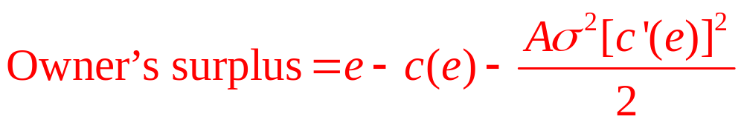
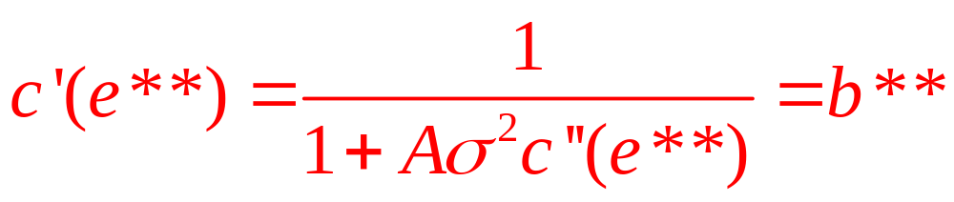
Second Best (Hidden-Action Case)
Owner’s surplus as a function of manager’s effort
The second-best effort e** satisfies the first-order condition

Slide 24
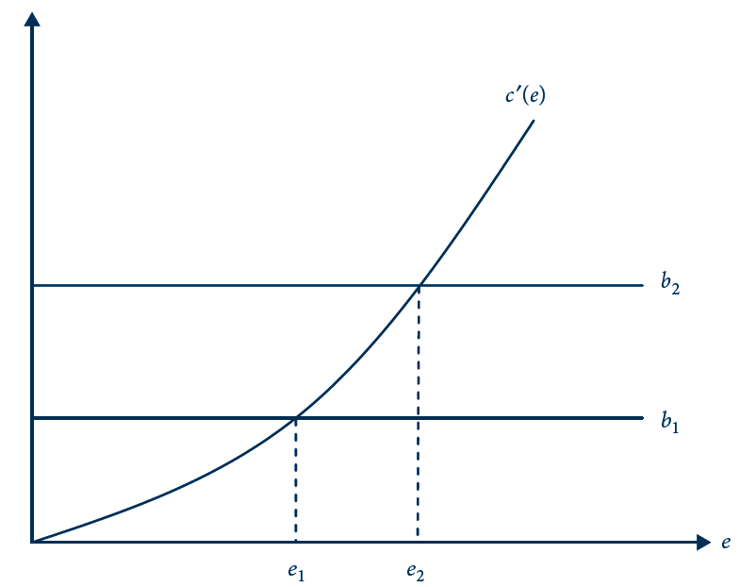
18.2 Manager’s Effort Responds to Increased
Incentives
Because the manager’s marginal cost of effort, c’(e), slopes upward, an increase in the power of the incentive scheme from b₁ to b₂ induces the manager to increase his effort from e₁ to e₂.

Slide 25
Second Best (Hidden-Action Case)
Because c’(e**) < 1 - c’(e*), and e** < e*
  The presence of asymmetric information leads to lower equilibrium effort
  The fundamental trade-off in the owner-manager relationship is between incentives and insurance
  The more risk averse is the manager, the more important is insurance relative to incentives

Slide 26
18.1 Owner-Manager Relationship
Assume
  Manager’s cost of effort: c(e) = e²/2
  σ² = 1
First best
  c’(e*) = e* = 1
  First-best effort e* = 1
  Manager’s fixed salary = ½
  Owner’s net profit = ½

Slide 27
18.1 Owner-Manager Relationship
Second best, assume A = 1
  Then e** = ½ and b** = ½; a** = 0
  The manager receives no fixed pay
    But does receive incentive pay equal to 50 cents for every dollar of gross profit
  Owner’s expected net profit = ¼
Second best, assume A = 2
  Then e** = 1/3 and b** = 1/3 ; a** = 1/18
  Owner’s expected net profit = 1/6

Slide 28
Comparison to Standard Model of the Firm
Hidden information vs. perfectly competitive market with no asymmetric information:
  Possibility of shirking and inefficiency
    Not in the standard model
  The manager becomes a unique sort of input
    His productivity depends on how his compensation is structured

Slide 29
Moral Hazard in Insurance
If a person is fully insured
  He will have a reduced incentive to undertake precautions
  May increase the likelihood of a loss occurring
Moral hazard
  The effect of insurance coverage on an individual’s precautions
  Which may change the likelihood or size of losses

Slide 30
Mathematical Model
Risk-averse individual
  Faces the possibility of a loss (l)
  That will reduce his initial wealth (W₀)
  The probability of loss is π
  An individual can reduce π by spending more on preventive measures (e)

Slide 31
Mathematical Model
An insurance company (principal)
  Offers a contract involving a payment of x to the individual if a loss occurs
  The premium is p
If the individual takes the coverage
  Expected utility: (1-π)U(W₁) + (π)U(W₂)
    Wealth in state 1 (no loss): W₁ = W₀-e-p
    Wealth in state 2 (loss): W₂ = W₀-e-p-l+x
Maximize: expected insurance profit = p - πx

Slide 32
First Best Insurance Contract
Insurance company - perfectly monitor e
  Set the terms to maximize its expected profit - subject to the participation constraint
    (1-π)U(W₁) + πU(W₂) ≥ Ū
  Will result in full insurance with x = l
  The individual will choose the socially efficient level of precaution

Slide 33
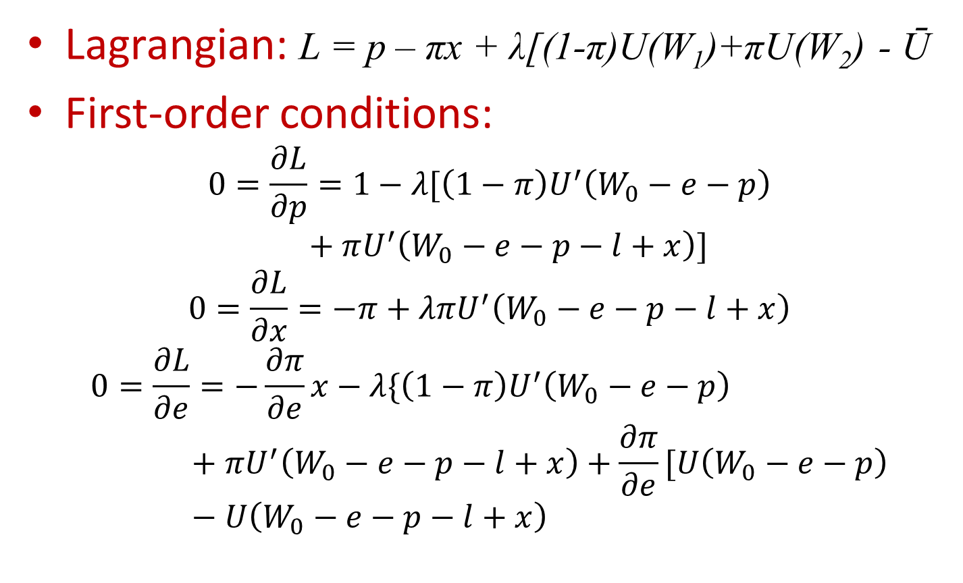
First Best Insurance Contract
Lagrangian: L = p – πx + λ[(1-π)U(W₁)+πU(W₂) - Ū
First-order conditions:
$$0=\frac{∂L}{∂p}=1−λ[\left(1−π\right)U^{′}\left(W_{0}−e−p\right)+πU^{′}\left(W_{0}−e−p−l+x\right)]$$
$$0=\frac{∂L}{∂x}=−π+λπU^{′}\left(W_{0}−e−p−l+x\right)$$
$$0=\frac{∂L}{∂e}=−\frac{∂π}{∂e}x−λ\{\left(1−π\right)U^{′}\left(W_{0}−e−p\right)+πU^{′}\left(W_{0}−e−p−l+x\right)+\frac{∂π}{∂e}[U\left(W_{0}−e−p\right)−U\left(W_{0}−e−p−l+x\right)$$

Slide 34
Second-Best Insurance Contract
Insurance company cannot monitor e
  Add incentive compatibility constraint:
    Agent is free to choose the level of precaution that suits him and maximizes his expected utility (1-π)U(W₁)+π(W₂)
The second-best contract will typically not involve full insurance
  Exposing the individual to some risk induces him to take some precaution

Slide 35
18.2 Insurance and Precaution against Car Theft
Driver endowed with $100,000 of wealth
  Purchase insurance against the theft of a $20,000 car
  If installs a car alarm that costs $1,750
    Probability of theft drops from 0.25 to 0.15
No insurance
  No car alarm: Expected utility = 11.45714
  Install car alarm: Expected utility = 11.46113

Slide 36
18.2 Insurance and Precaution against Car Theft
First best
  Maximizes the insurance company’s profit
    Given that it requires the individual to install an alarm
    Can costlessly verify whether the individual has complied
  Full insurance
  Highest premium p = 3,298
  Company’s profit = $298

Slide 37
18.2 Insurance and Precaution against Car Theft
Second best
  Company cannot monitor whether the individual has installed an alarm
  1. Induce him to install the alarm by offering only partial insurance
    Payment after theft = $3,374
    p = $602 and company’s profit = $96
  2. Disregard the alarm and provide him with full insurance
    p = $5,048 and company’s profit = $48

Slide 38
Competitive Insurance Market
Competitive insurers
  The first best maximizes the insurance customer’s expected utility
    Given that the contract can specify his precaution level
  The second best maximizes the customer’s expected utility
    Under the constraint that his precaution level must be induced by having the contract offer only partial insurance

Slide 39
18.3 Competitive Theft Insurance
Car theft insurance
  Is sold by perfectly competitive companies
First best
  Require him to install the alarm
  Fully insure him for p = $3,000
    Fair insurance premium = the expected payout for a loss
  Firm earns zero profit
Second best
  Equilibrium premium, p = $506
  Payment for loss is = $3,374

Slide 40
Hidden Types
In the hidden-type model
  The individual has private information about an innate characteristic he cannot choose
The agent’s private information
  At the time of signing the contract
  Puts him in a better position

Slide 41
Hidden Types
The principal
  Will try to extract as much surplus as possible from agents through clever contract design
  Include options targeted to every agent type

Slide 42
Nonlinear Pricing
A monopolist (the principal)
  Who sells to a consumer (the agent) with private information about his own valuation for the good
  Offers a nonlinear price schedule
    Menu of different-sized bundles at different prices
    Larger bundles sell for lower per-unit price

Slide 43
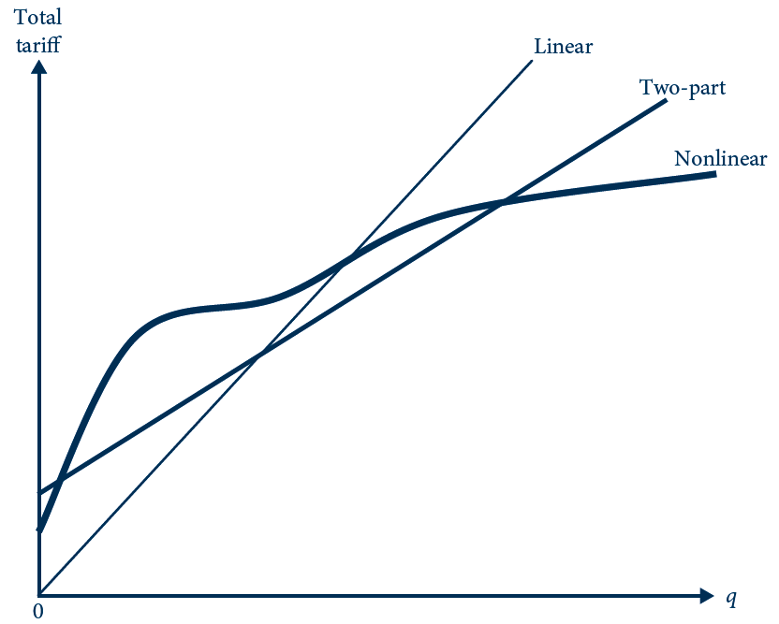
18.3 Shapes of Various Pricing Schedules
The graph shows the shape of three different pricing schedules. Darker curves are more complicated pricing schedules and so represent more sophisticated forms of second-degree price discrimination.

Slide 44
Mathematical Model
A single consumer obtains surplus, U
  From consuming a bundle of q units
  For which he pays a total tariff of T
U = θv(q) – T
    Assume that v’(q) > 0 and v’’(q) < 0
The consumer’s type is θ
  θ_{H} is the “high” type (with probability of β)
  θ_{L} is the “low” type (with probability of 1-β)

Slide 45
Mathematical Model
The consumer’s type is θ
  0 < θ_{L} < θ_{H}
The monopolist
  Has a constant average and marginal cost of c
  Profit from selling q units is
Π = T – cq

Slide 46
First-Best Nonlinear Pricing
The monopolist observes θ
Participation constraint: θv(q) – T ≥ 0
At the optimum: θv’(q) = c
  The marginal social benefit of increased quantity [the consumer’s marginal private benefit]
  Is equal to the marginal social cost [the monopolist’s marginal cost]

Slide 47
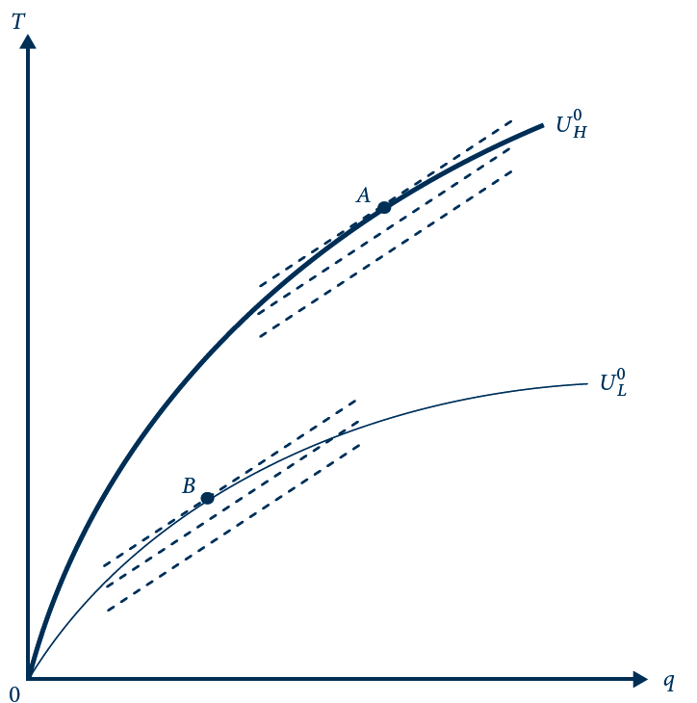
18.4 First-Best Nonlinear Pricing
The consumer’s indifference curves over the bundle of contractual terms are drawn as solid lines (the darker one for the high type and lighter for the low type); the monopolist’s isoprofits are drawn as dashed lines. Point A is the first-best contract option offered to the high type, and point B is that offered to the low type.

Slide 48
Second-Best Nonlinear Pricing
The monopolist cannot observe the consumer’s type
  Knows the distribution
  Choosing A is no longer incentive compatible for the high type
  The monopolist must reduce the high-type’s tariff, offering C instead of A

Slide 49
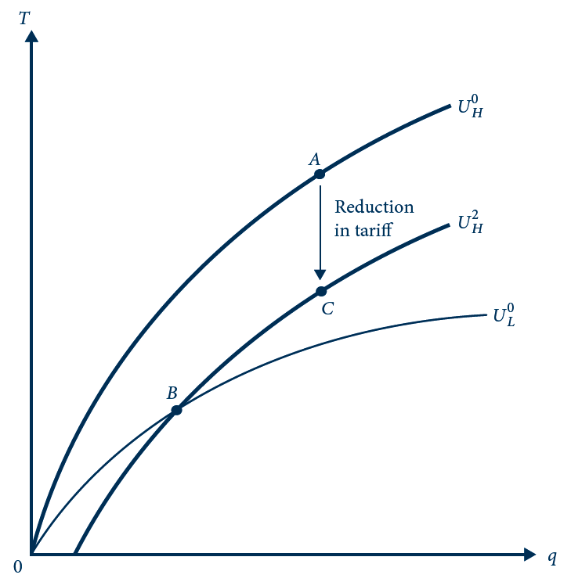
18.5 First Best Not Incentive Compatible
The first-best contract, involving points A and B, is not incentive compatible if the consumer has private information about his type. The high type can reach a higher indifference curve by choosing the bundle (B) that is targeted at the low type. To keep him from choosing B, the monopolist must reduce the high type’s tariff by replacing bundle A with C.

Slide 50
Second-Best Nonlinear Pricing
The second-best contract
  Menu that targets bundle (q_{H}, T_{H}) at the high type and (q_{L}, T_{L}) at the low type
  Maximizes the monopolist’s expected profit:
  β(T_{H} – cq_{H}) = (1 – β)(T_{L} – cq_{L})
  Subject to four constraints
  θ_{L}ν(q_{L}) – T_{L} ≥ 0, θ_{H}ν(q_{H}) – T_{H} ≥ 0
  θ_{L}ν(q_{L}) – T_{L} ≥ θ_{L}ν(q_{H}) – T_{H}
  θ_{H}ν(q_{H}) – T_{H} ≥ θ_{H}ν(q_{L}) – T_{L}

Slide 51
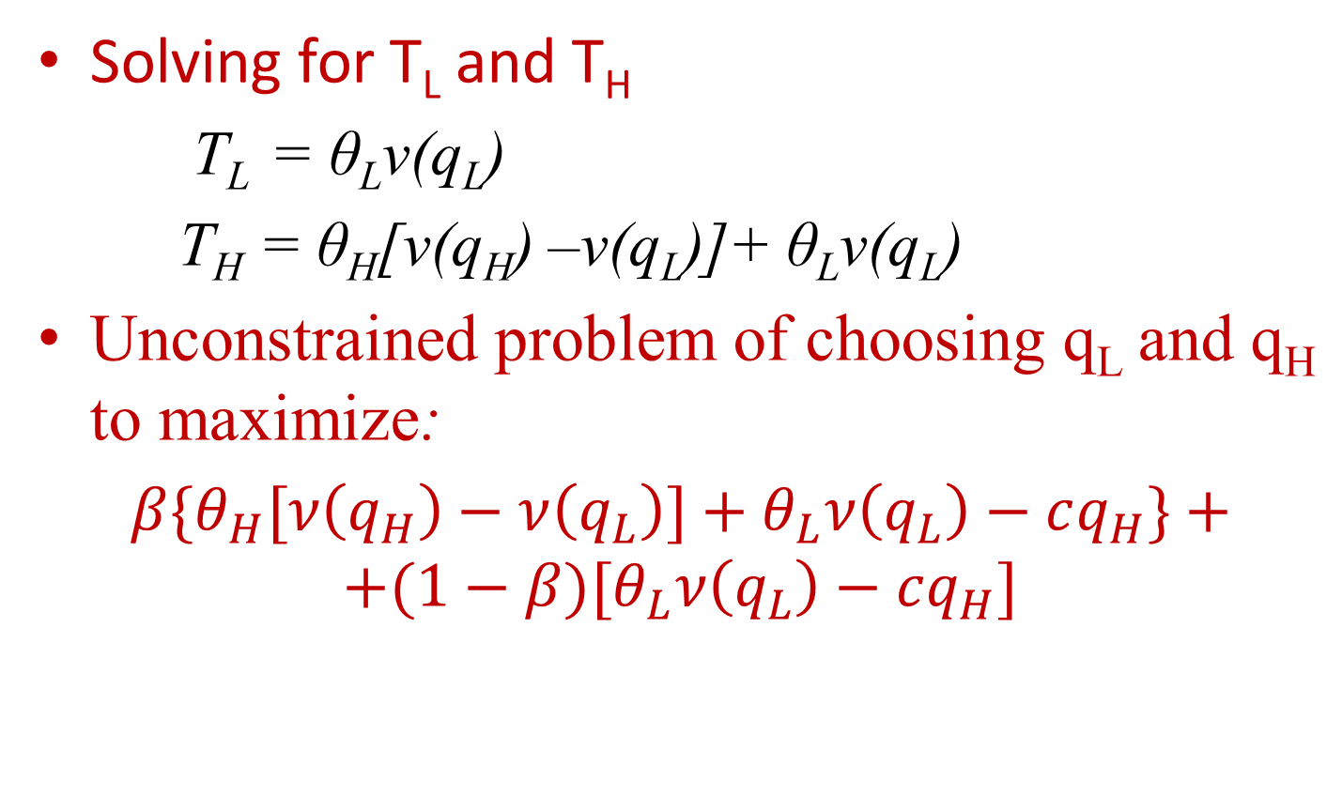
Second-Best Nonlinear Pricing
Solving for T_{L} and T_{H}
  T_{L} = θ_{L}ν(q_{L})
  T_{H} = θ_{H}[ν(q_{H}) –ν(q_{L})]+ θ_{L}ν(q_{L})
Unconstrained problem of choosing q_{L} and q_{H} to maximize:
$β\{θ_{H}[ν\left(q_{H}\right)−$ $ν\left(q_{L}\right)]+θ_{L}ν\left(q_{L}\right)−cq_{H}\}+$
$$+(1−β)[θ_{L}ν\left(q_{L}\right)−cq_{H}]$$

Slide 52
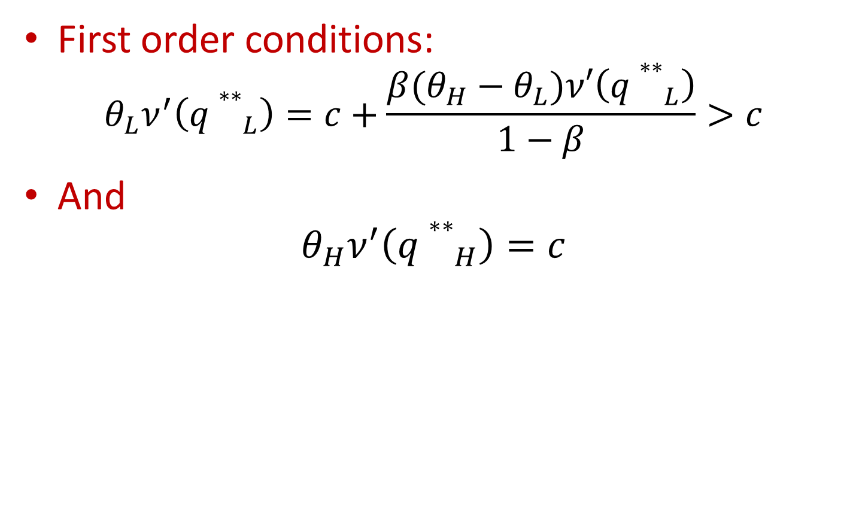
Second-Best Nonlinear Pricing
First order conditions:
$$θ_{L}ν^{′}\left({q∗∗}_{L}\right)=c+\frac{β(θ_{H}−θ_{L})ν′\left({q∗∗}_{L}\right)}{1−β}>c$$
And
$$θ_{H}ν^{′}\left({q∗∗}_{H}\right)=c$$

Slide 53
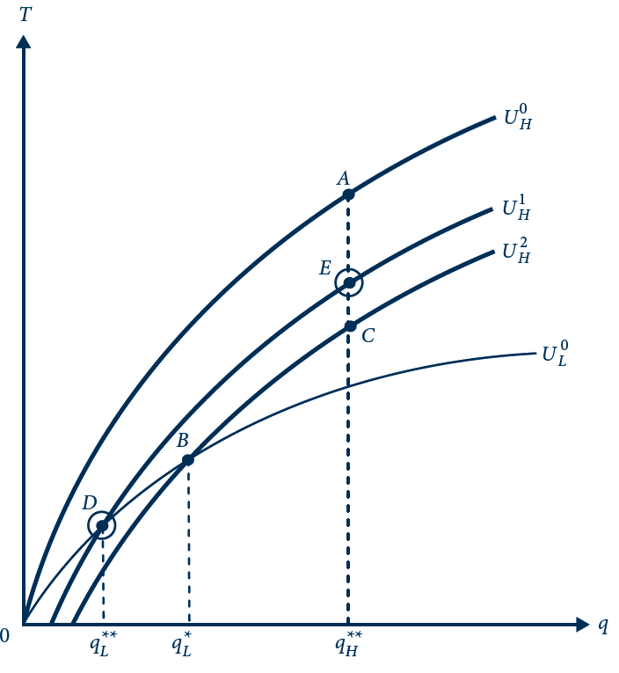
18.6 Second-Best Nonlinear Pricing
The second-best contract is indicated by the circled points D and E. Relative to the incentive-compatible contract found in Figure 18.5 (points B and C), the second-best contract distorts the low type’s quantity (indicated by the move from B to D) in order to make the low type’s bundle less attractive to the high type. This allows the principal to charge tariff to the high type (indicated by the move from C to E).

Slide 54
18.4 Monopoly Coffee Shop
The college has a single coffee shop
  Faces a marginal cost of 5 cents per ounce
The representative customer faces an equal probability of being one of two types
  A coffee hound (θ_{H} = 20)
  A regular Joe (θ_{L} = 15)
Assume v(q) = 2q^{0.5}

Slide 55
18.4 Monopoly Coffee Shop
First best
  Substituting such that marginal cost = marginal benefit, we get
q = (θ/c)²
q*_{L} = 9 q*_{H} = 16
T*_{L} = 90 T*_{H} = 160
Expected profit = 62.5

Slide 56
18.4 Monopoly Coffee Shop
Incentive compatibility when types are hidden
  The first-best pricing scheme is not incentive compatible if the monopolist cannot observe type
    Keeping the cup sizes the same, the price for the large cup would have to be reduced by 30 cents
    The shop’s expected profit falls to 47.5

Slide 57
18.4 Monopoly Coffee Shop
Second best
  The shop can do better by reducing the size of the small cup
  The size that is second best would be
θ_{L}q_{L}^{-0.5} = c + (θ_{H} - θ_{L})q_{L}^{-0.5}
q**_{L} = 4
T**_{L} = 60
Expected profit = 50

Slide 58
Continuum of Types
Consumer’s type, θ
  Continuous between θ_{L} and θ_{H}
  Let
    φ(θ) be the associated probability density function
    And Φ(θ) the cumulative distribution function
  Monopolist offers a menu of bundles
    Specification of quantity q(θ) and tariff T(θ)
    Continuous schedule

Slide 59
Continuum of Types
Consumer’s utility function: U(θ) = θν(q(θ)) – T(θ)
The monopolist’s profit from serving type θ: Π(θ) = T(θ) – cq(θ)
First best:
  Socially optimal quantity: θν’(q) = c
  Tariff: T(θ) = θν(q(θ))
  Monopolist profits: θν(q(θ)) – cq(θ), all of social surplus

Slide 60
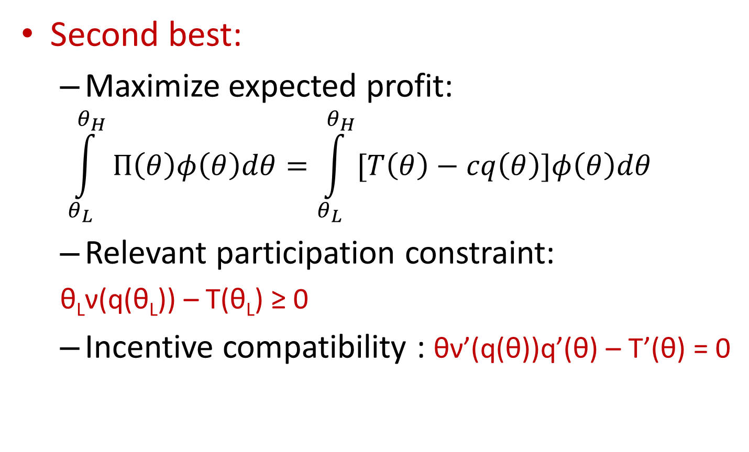
Continuum of Types
Second best:
  Maximize expected profit:
  $$\int_{θ_{L}}^{θ_{H}}{Π\left(θ\right)φ\left(θ\right)dθ=\int_{θ_{L}}^{θ_{H}}{[T\left(θ\right)−cq\left(θ\right)]φ\left(θ\right)dθ}}$$
  Relevant participation constraint:
  θ_{L}ν(q(θ_{L})) – T(θ_{L}) ≥ 0
  Incentive compatibility : θν’(q(θ))q’(θ) – T’(θ) = 0

Slide 61
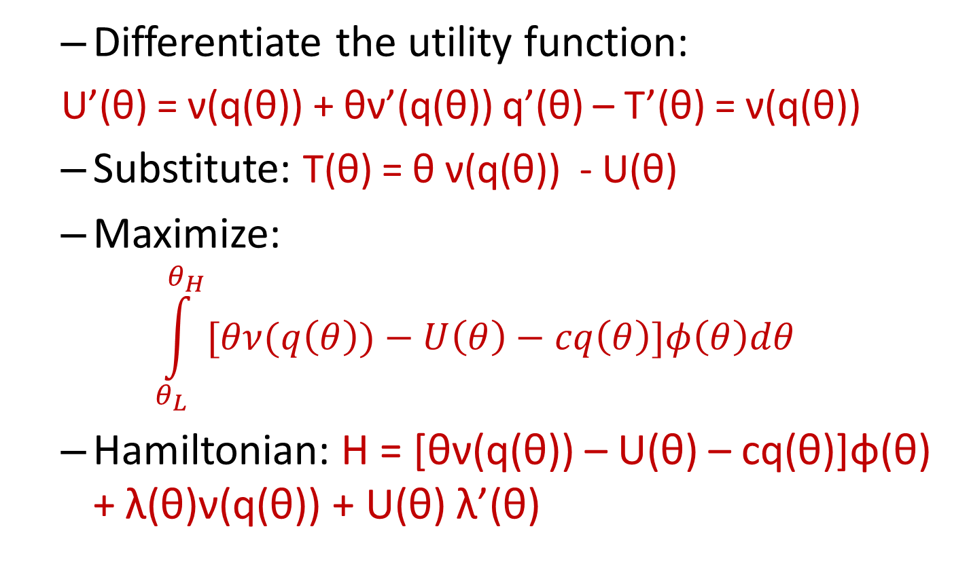
Continuum of Types
  Differentiate the utility function:
  U’(θ) = ν(q(θ)) + θν’(q(θ)) q’(θ) – T’(θ) = ν(q(θ))
  Substitute: T(θ) = θ ν(q(θ)) - U(θ)
  Maximize:
$$\int_{θ_{L}}^{θ_{H}}{[θν(q\left(θ\right))−U\left(θ\right)−cq\left(θ\right)]φ\left(θ\right)dθ}$$
  Hamiltonian: H = [θν(q(θ)) – U(θ) – cq(θ)]φ(θ) + λ(θ)ν(q(θ)) + U(θ) λ’(θ)

Slide 62
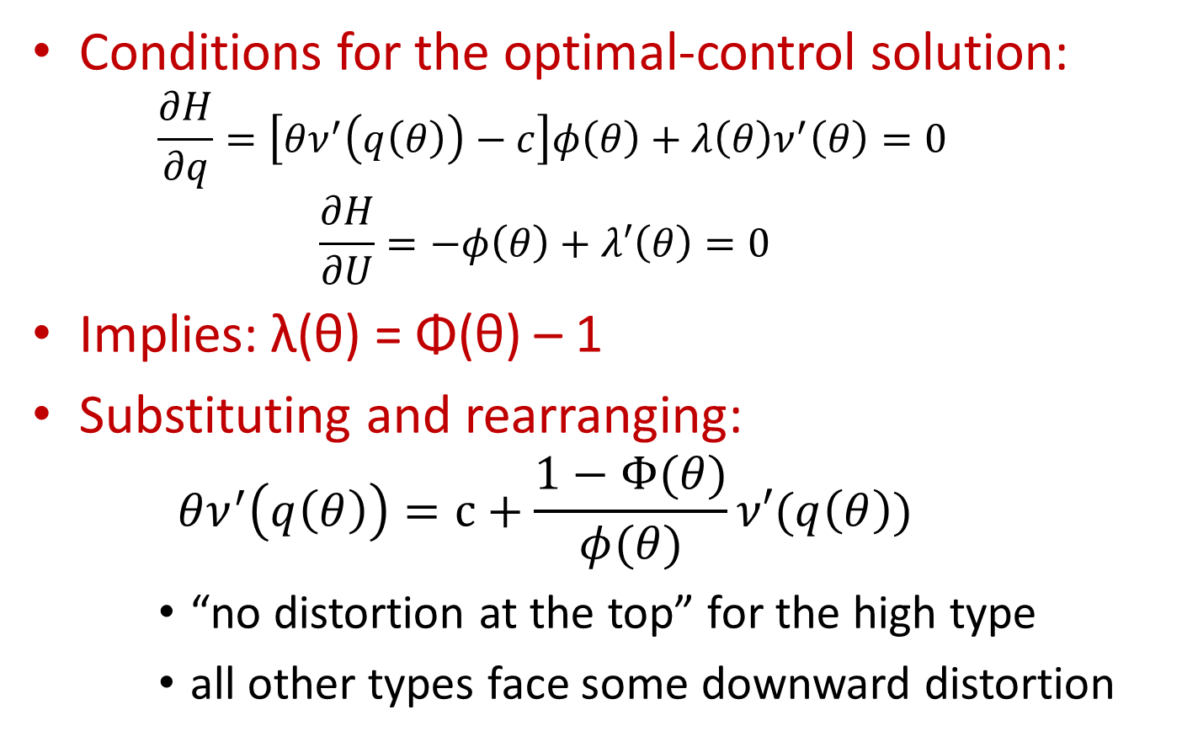
Continuum of Types
Conditions for the optimal-control solution:
    $$\frac{∂H}{∂q}=\left[θν^{′}\left(q\left(θ\right)\right)−c\right]φ\left(θ\right)+λ\left(θ\right)ν^{′}\left(θ\right)=0$$
    $$\frac{∂H}{∂U}=−φ\left(θ\right)+λ′\left(θ\right)=0$$
Implies: λ(θ) = Φ(θ) – 1
Substituting and rearranging:
    $$θν^{′}\left(q\left(θ\right)\right)=c+\frac{1−Φ(θ)}{φ(θ)}ν′(q\left(θ\right))$$
    “no distortion at the top” for the high type
    all other types face some downward distortion

Slide 63
Adverse Selection in Insurance
Adverse selection
  Is a problem facing insurers where the risky types are more likely to accept an insurance policy and are more expensive to serve
  Assume policy holders may be one of two types
    θ_{H} = high risk
    θ_{L} = low risk

Slide 64
First Best
The insurer can observe the individual’s risk type
First best involves full insurance
  Different premiums are charged to each type to extract all surplus

Slide 65
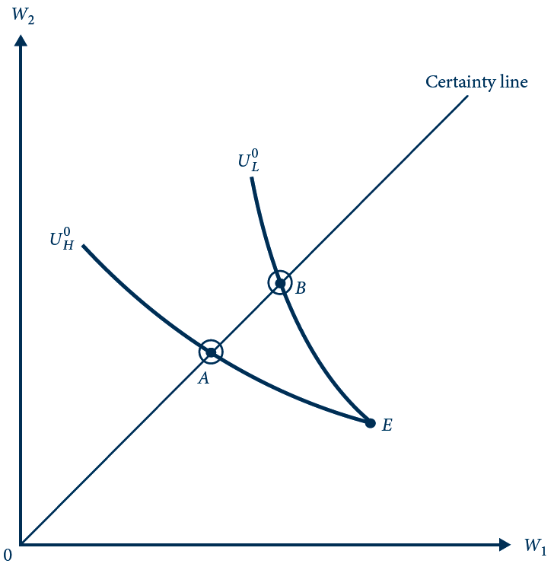
18.7 First Best for a Monopoly Insurer
In the first best, the monopoly insurer offers policy A to the high-risk type and B to the low-risk type. Both types are fully insured. The premiums are sufficiently high to keep each type on his indifference curve through the no-insurance point (E).

Slide 66
Second Best
The insurer cannot observe type
  First-best contracts will not be incentive compatible
  If the insurer offered A and B, the high-risk type would choose B
  The insurer must change the coverage offered to low-risk individuals to make it unattractive to high-risk individuals

Slide 67
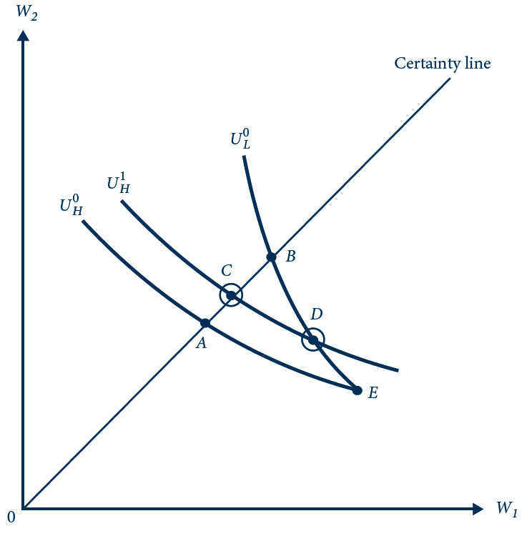
18.8 Second Best for a Monopoly Insurer
Second-best insurance policies are represented by the circled points: C for the high-risk type and D for the low-risk type.

Slide 68
18.5 Insuring the Little Red Corvette
Probability of theft
  Depends on the color of the car
  Probability of theft is higher for red cars (π_{H} = 0.25) than for gray cars (π_{L} = 0.15)
First best
  The monopoly insurer
    Can observe the car color
    Offer different policies for different colors
  Both colors are fully insured for the $20,000 loss of the car

Slide 69
18.5 Insuring the Little Red Corvette
First best
  Premium = maximum amount that each type would be willing to pay in lieu of going without insurance
    = $5,426 for the high type (red cars)
    = $3,287 for the gray cars
  Expected profit from a policy
    Sold for a red car = $426
    Sold for a gray car = $287

Slide 70
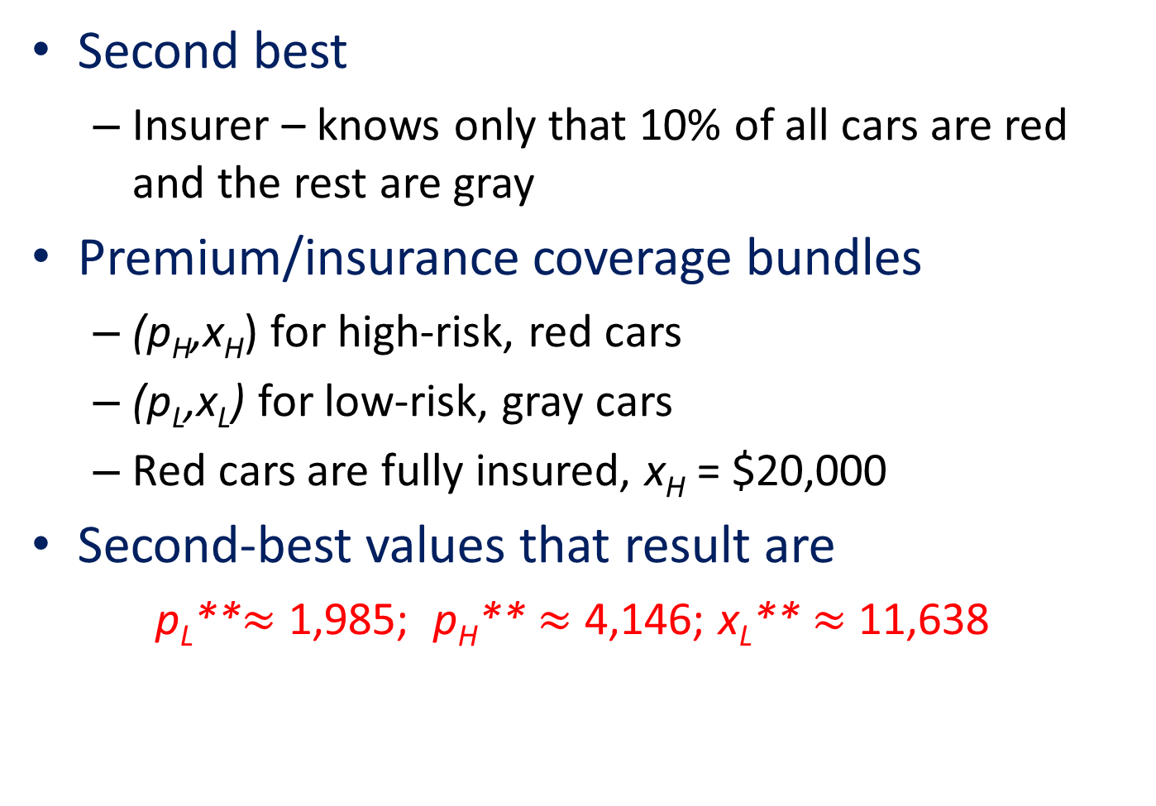
18.5 Insuring the Little Red Corvette
Second best
  Insurer – knows only that 10% of all cars are red and the rest are gray
Premium/insurance coverage bundles
  (p_{H},x_{H}) for high-risk, red cars
  (p_{L},x_{L}) for low-risk, gray cars
  Red cars are fully insured, x_{H} = $20,000
Second-best values that result are
    p_{L}**$≈$ 1,985; p_{H}** $≈$ 4,146; x_{L}** $≈$ 11,638

Slide 71
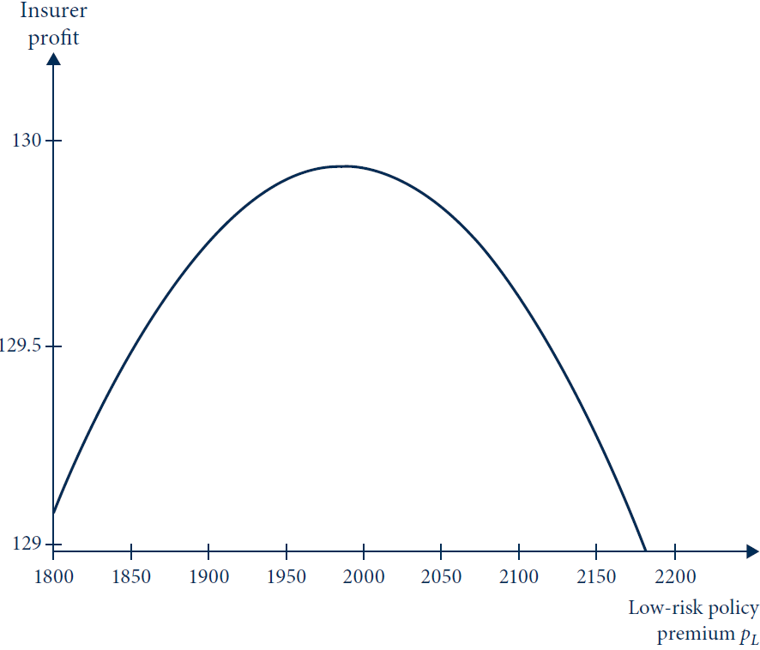
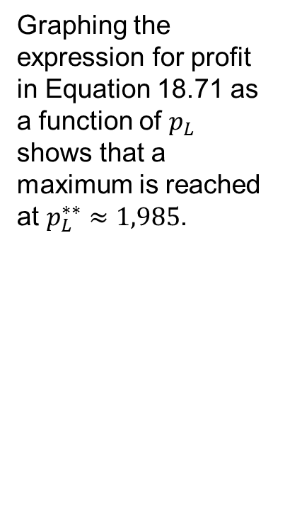
18.9 Solving for Second Best in the Numerical
Example
Graphing the expression for profit in Equation 18.71 as a function of $p_{L}$ shows that a maximum is reached at $p_{L}^{∗∗}≈1,985$.

Slide 72
Competitive Insurance Market
Insurance is provided by a perfectly competitive market
  Fair insurance
  Each type receives full insurance at a fair premium

Slide 73
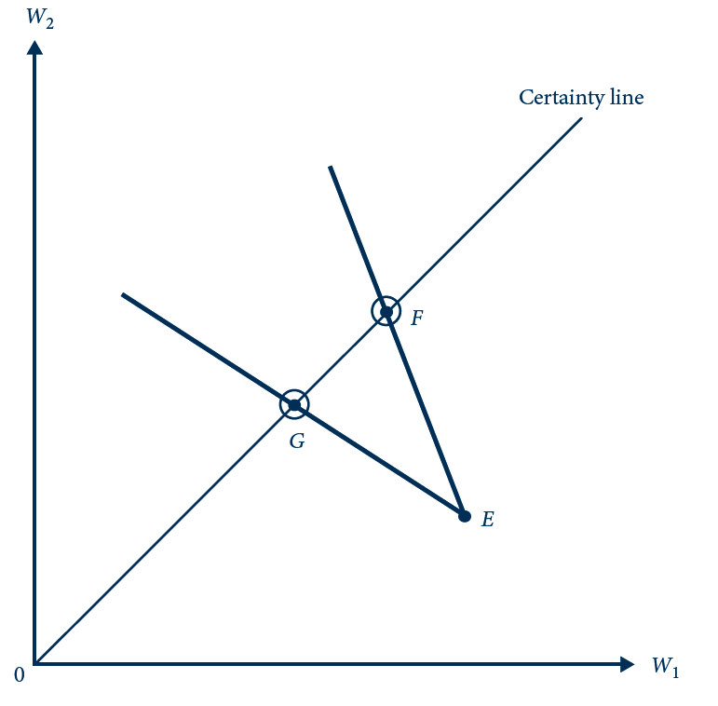
18.10 Competitive Insurance Equilibrium with
Perfect Information
With perfect information, the competitive insurance market results in full insurance at fair premiums for each type. The high type is offered policy G; the low type, policy F.

Slide 74
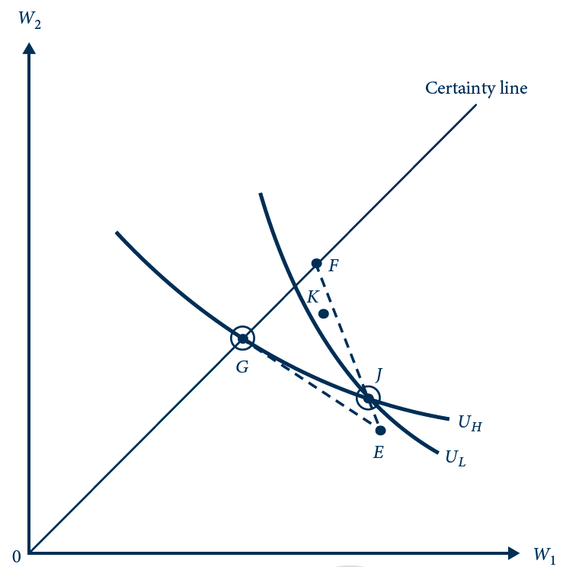
18.11 Competitive Insurance Equilibrium with
Hidden Types
With hidden types, the high-risk type continues to be offered first-best policy G but the low-risk type is rationed, receiving only partial insurance at J in order to keep the high-risk type from pooling.

Slide 75
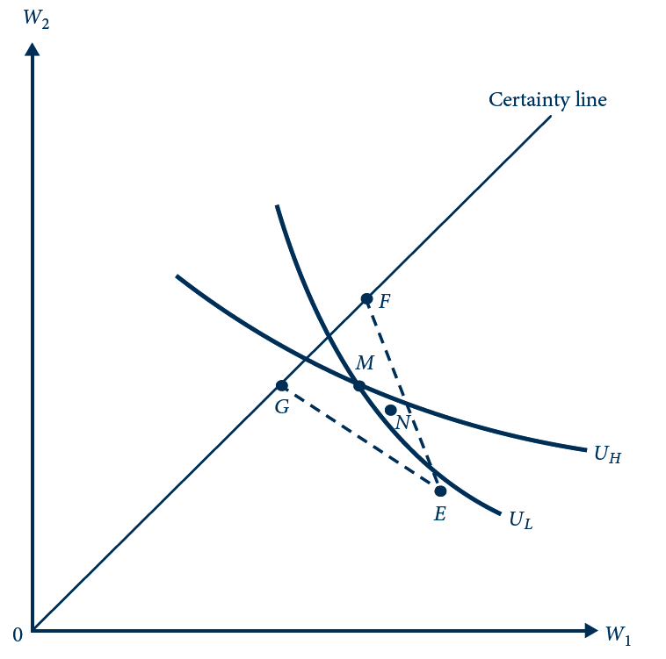
18.12 Impossibility of a Competitive Pooling
Equilibrium
Pooling contract M cannot be an equilibrium because there exist insurance policies such as N that are profitable to insurers and are attractive to low-risk types but not to high-risk types.

Slide 76
18.6 Competitive Insurance for the Little Red Corvette
Insurance - competitive market
Full information
  Competitive equilibrium - full insurance for both types
    Fair premium of $5,000 for high-risk, red cars
    Fair premium of $3,000 for low-risk, gray cars
If insurers cannot observe car colors
  Red cars – same as under full information
  Gray cars - involves a fair premium p_{L} = 0.15x_{L}
    p_{L}^{C} ≈ 453 and x_{L}^{C}≈ 3,021

Slide 77
Market Signaling
If the informed player moves first, he can “signal” his type to the other party
  The low-risk individual would benefit from providing his type to insurers
    He should be willing to pay the difference between his equilibrium and his first-best surplus to issue such a signal

Slide 78
18.7 Certifying Car Color
Competitive market for automobile insurance
  Owner of a gray car
    R – the most that he would be willing to pay to have his car color certified and reported to the market
      Fully insured at a fair premium of $3,000
      Earns surplus: ln(100,000 - 3,000 - R)
    Without the certified report
      Expected surplus: 0.85 ln(100,000 – 453) + 0.15 ln(100,000 - 453 - 20,000 + 3,020) = 11.4803
    R = 207

Slide 79
18.7 Certifying Car Color
Competitive market for automobile insurance
  Owner of a red car
    Would pay a bribe as high as $2,000
      The difference between his fair premium with full information ($5,000)
      And the fair premium charged to an individual known to be of low risk ($3,000)

Slide 80
Market for Lemons
Sellers of used cars
  Have more information on the condition of the car
  But the act of offering the car for sale can serve as a signal of car quality
    It must be below some threshold that would have induced the owner to keep it

Slide 81
Market for Lemons
Suppose there is a continuum of qualities
  From low-quality lemons to high-quality gems
  Only the owner knows a car’s type
Buyers cannot determine the quality
  All used cars sell for the same price
  Function of average car quality

Slide 82
Market for Lemons
A car’s owner - keep a car that is in the upper end of the spectrum
  Sell a car that is in the lower end of the spectrum
  Reduces the average quality
  Reduces the market price
  Leads sellers of the high end of the remaining cars to keep their cars
    Reduces average quality and market price

Slide 83
18.8 Used-Car Market
Quality, q, of used cars
  Is uniformly distributed between 0 and 20,000
Sellers
  Value their cars at q
Buyers
  Place a higher value on cars, q + b
Full information about quality
  All used cars would be sold

Slide 84
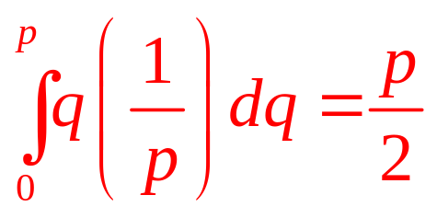
18.8 Used-Car Market
Sellers have private information about quality
  And buyers know only the distribution
  Market price, p
  Sellers offer their cars for sale if and only if q ≤ p
  Quality of a car offered for sale
    Uniformly distributed between 0 and p
  Expected quality:
  Buyer’s expected net surplus = b – p/2
  One equilibrium: p*=2b

Slide 85
Auctions
A seller
  Can often do better if several buyers compete against each other
  High-value consumers are pushed to bid high
Different formats may lead to different outcomes
  Sellers should think carefully about how to design the auction

Slide 86
Auctions
First-price sealed auction bid
  All bidders simultaneously submit secret bids
  The auctioneer unseals the bids and awards the object to the highest bidder
  The highest bidder pays his own bid
  Weakly dominated strategy to submit a bid b greater than or equal to the buyer’s valuation v

Slide 87
Auction
Weakly dominated strategy
  If there is another strategy that does at least as well against all rivals’ strategies and strictly better against at least one
First-price sealed auction bid
  A buyer receives no surplus if he bids b=v
    No matter what his rivals bid
  By bidding b < v, there is a chance for some positive surplus

Slide 88
Auction
Second-price sealed auction bid
  The highest bidder pays the next highest bid rather than his own
  Induce bidders to reveal their valuations
All bidding strategies
  Are weakly dominated by the strategy of bidding exactly one’s valuation
    The winner’s bid does not affect the amount he has to pay; that depends on someone else’s bid

Slide 89
18.9 Art Auction
Two buyers - bid for a painting in a first-price sealed-bid auction
  Buyer i’s valuation, v_{i}
    Random variable, uniformly distributed between 0 and 1
    Independent of the other buyer’s valuation
  Buyers’ valuations are private information
  Symmetric equilibrium
    Buyers bid a constant fraction of their valuations, b_{i} = kv_{i}
  Solve for the equilibrium value of k

Slide 90
18.9 Art Auction
Symmetric equilibrium
  Buyer 1
    Knows his own type v₁
    Knows buyer 2’s equilibrium strategy b₂ = kv₂
    Best responds by choosing the bid b₁ maximizing his expected surplus = (b₁/k)(v₁-b₁)
  So, b₁ = v₁/2, k*= ½

Slide 91
18.9 Art Auction
Order statistics
k^{th} -order statistic, X_{(k)}
  The k^{th} lowest draw from
  n independent draws made from the same distribution, arranged from smallest to largest
Expected value of the kth-order statistic
  n draws taken from a uniform distribution between 0 and 1
  E(X_{(k)}) = k/(n+1)

Slide 92
18.9 Art Auction
Expected revenue
  From the first-price auction = E(max(b₁,b₂))=(1/2) E(max(v₁,v₂)) = 1/3
    Because max(v₁,v₂) is the largest-order statistic from two draws of a uniform random variable between 0 and 1
Second-price auction
  Buyers bid their true valuations: b_{i} = v_{i}
  Seller’s expected revenue = E(min(b₁, b₂)) = 1/3
    Because min(b₁, b₂) = min(v₁, v₂)

Slide 93
Auction
Common values auctions
  The good has the same value to all bidders
  But they do not know exactly what that value is
  The winner’s curse
    The winning bidder realizes that every other bidder though the object was worth less
    He probably overestimated the value when bidding

Slide 94
Using Experiments To Measure Asymmetric-Information Problems
Theoretical case
  Moral hazard and adverse selection are market imperfections with the potential to reduce welfare relative to a full-information setting
Empirical question
  Whether these market imperfections are substantial in real-world markets

Slide 95
Natural and Field Experiments
Natural experiments
  Not personally designed by the researcher
  Arise from significant natural events or government-policy changes
    Produce data much as would a well-designed experiment
Field experiments
  Designed by researchers
    With the explicit intention to identify and measure asymmetric-information problems

Slide 96
Extending the Theory
Measure aggregate welfare in a population facing uncertainty
  Well-being of one consumer facing an uncertain situation = certain equivalent
  Overall social welfare = consumer surplus + profits
Policies addressing one form of asymmetric-information problem can exacerbate the other
  Government mandate of full insurance
    Can eliminate adverse selection
    Can reduce welfare if moral hazard is the main information problem

Slide 97
Moral Hazard in Health Insurance
Moral hazard in healthcare
  Individuals consume more medical services if some or all is covered by insurance and less is paid out of pocket
Rapid rise in healthcare expenditures
  Could be stemmed by offering less than full insurance
    Confronting consumers with copayments and deductibles
  The effect depends on the elasticity of healthcare expenditures with respect to price

Slide 98
Moral Hazard in Health Insurance
The Rand (field) experiment
  1970s, 6000 participants
  Copayments 0, 25, 50, and 95%, randomized
  Estimated linear demand p(q), p = 288 – 0.39q
  Marginal cost curve for healthcare, mc(q)
  Copayment < 100% leads to overconsumption
  Deadweight loss from moral hazard = 28%
  The estimated demand curve is quite inelastic
  Confronting consumers with more of the cost of their healthcare decisions will not stem much of the increase in medical expenditures

Slide 99

18.2 Key results from Rand health insurance experiment
Assigned Copayment (%) | Adjusted Annual Expenditure (1984 $) | Individuals
0 | 750 | 1,893
25 | 617 | 1,137
50 | 573 | 383
95 | 540 | 1,120

Slide 100
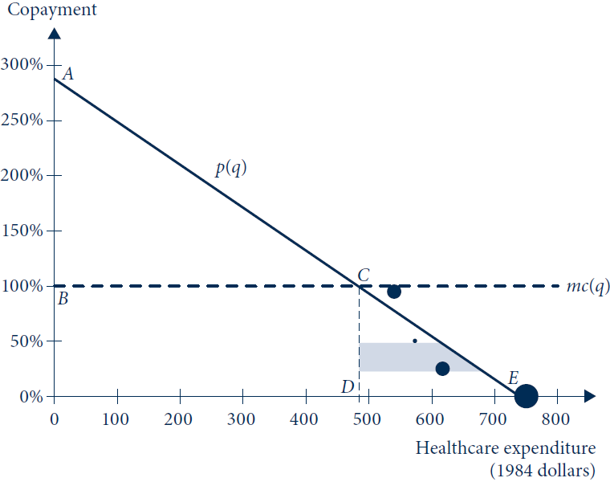
E18.1 Welfare Loss from Moral Hazard in Rand
Health Insurance Experiment
Filled circles are average expenditures for different copayments from the Manning et al. (1987) study. Individual consumer demand 𝑝(𝑞) estimated as the regression line fitting the circles, weighted by size (proportional to number of observations in group). Marginal cost curve 𝑚𝑐(𝑞) is a horizontal line of height 1 = 100%. First-best social welfare equals the area of triangle ABC. A consumer facing no copayment will overconsume healthcare, leading to deadweight loss equal to the area of triangle CDE. The deadweight loss from a reduction in copayment from 50% to 25% is shown as the shaded trapezoid.

Slide 101
Moral Hazard in Health Insurance
The 2008 Oregon(natural) experiment
  Want to expand Medicaid program but with facing a tight budget constraint
  Use lottery to allocate the insurance to 90,000 eligible citizens
  Access to Medicaid increased healthcare expenditures by $778, about a 25% increase
    30 % decrease in self reports of financial strain
    25% increase in self reports of being in good health
  Hints from the study: a lack of insurance may cause underconsumption

Slide 102
Adverse Selection in Health Insurance
The Alcoa natural experiment
  7 divisions, run by different managers
    Responsibility: set the terms of the benefits packages
    Premiums for two health insurance policies: a basic policy and a “gold” policy involving fuller insurance and a surcharge
    Price variation across divisions, fairly random

Slide 103
Adverse Selection in Health Insurance
The Alcoa natural experiment
  Demand curve for gold policy, P(Q) = 1,081-1,023Q
  Average cost of serving consumers selecting the gold policy , AC(Q) = 585 – 198Q
  Adverse selection: AC(Q) is downward sloping
  Equilibrium: P(Q) = AC(Q)
    Q_{c} = 60%, not efficient
  First best: P(Q) = MC(Q)
  Deadweight loss from undersupply: $12

Slide 104
18.3 Key results from Alcoa experiment
Premium Difference (2004 $) | Fraction Choosing “Gold” Contract | Average Cost (2004 $) | Individuals
384 | 0.67 | 451 | 2,939
466 | 0.66 | 499 | 67
495 | 0.64 | 459 | 526
570 | 0.46 | 493 | 199
659 | 0.49 | 489 | 41

Slide 105
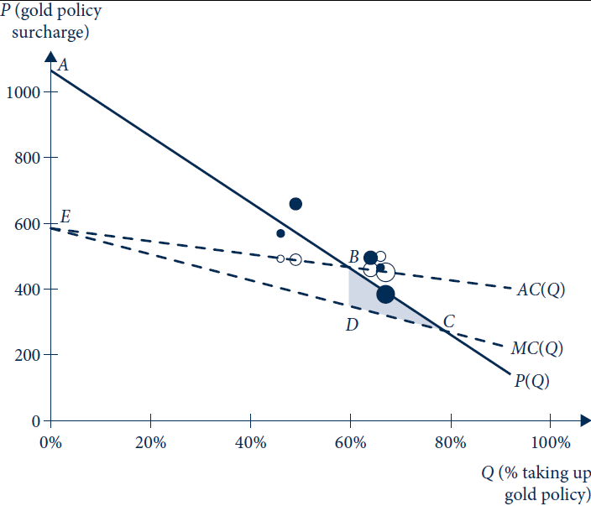
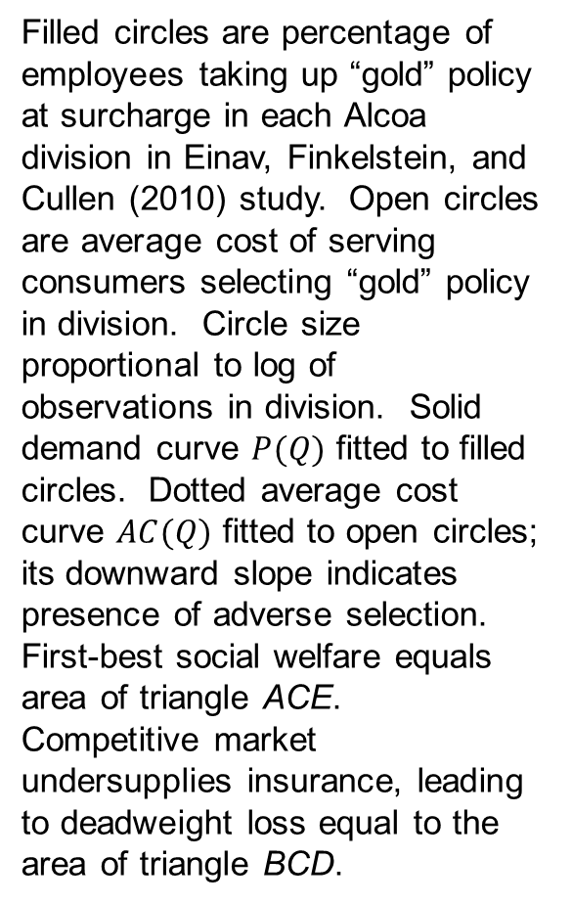
E18.2 Welfare Loss from Adverse Selection in
Alcoa Experiment
Filled circles are percentage of employees taking up “gold” policy at surcharge in each Alcoa division in Einav, Finkelstein, and Cullen (2010) study. Open circles are average cost of serving consumers selecting “gold” policy in division. Circle size proportional to log of observations in division. Solid demand curve $P(Q)$ fitted to filled circles. Dotted average cost curve $AC(Q)$ fitted to open circles; its downward slope indicates presence of adverse selection. First-best social welfare equals area of triangle ACE. Competitive market undersupplies insurance, leading to deadweight loss equal to the area of triangle BCD.

Slide 106
Asymmetric Information in Consumer Credit
A high interest rate
  Adverse selection: attracts only those high-risk borrowers unfazed by the interest rate because they are unlikely to pay the loan back in any event
  Moral hazard: why work hard and live frugally if most of the benefit is siphoned off by burdensome repayments?
  More defaults through a simple liquidity effect: higher interest rates lead to higher repayments, which may be difficult to afford on a given budget

Slide 107
Asymmetric Information in Consumer Credit
Miro-lending in South Africa, field experiment
  4,000 customers; high-interest rates
  Randomly selected customers receive one of three different interest rates
    Had little effect on probability of default
  Randomized surprise reward for timely repayment (promise to extend future loans at attractive rates)
    Significant effect

